Slide 1
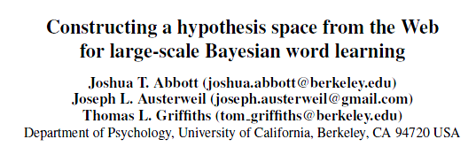
2012.11.07
김형준
Word Net
Xu and Tenenbaum
(2007)

Slide 2
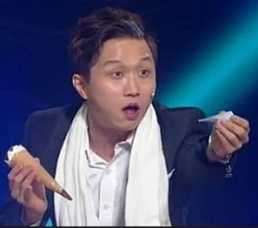
Introduction
What is the name(concept)
of this object?

Slide 3
Introduction
Generalization
Word Learning
Bayesian Word Learning <- Bayes’ rule

Slide 4
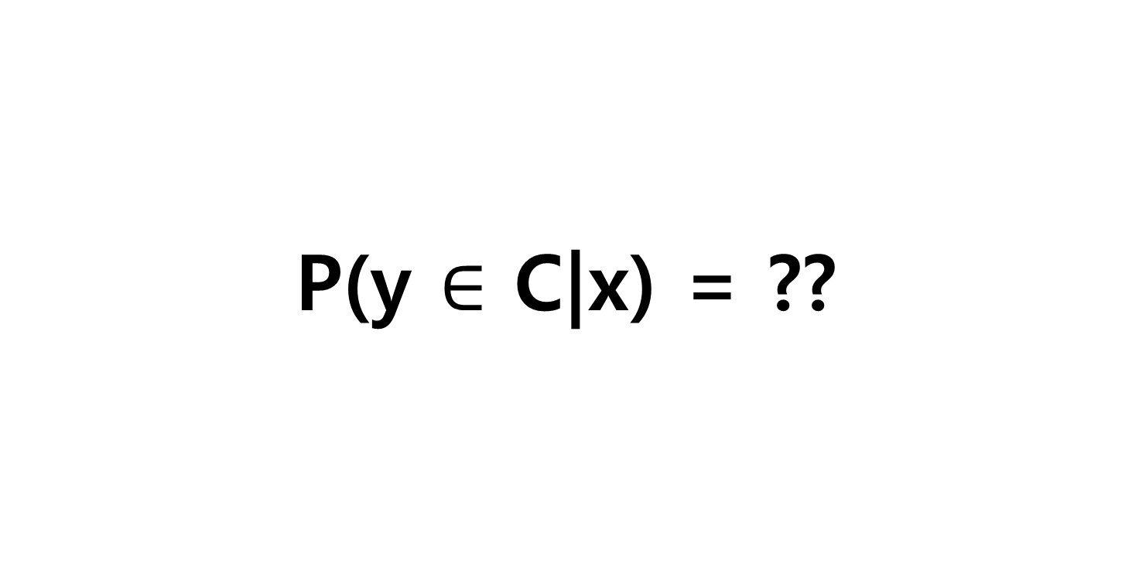
Main Problem?
P(y $∈$ C|x) = ??

Slide 5
Contents
Introduction
Basic Concepts
Xu and Tenenbaum(2007) using Hierarchical Clustering
Abbott, Austerweil and Griffiths(2012) using Word Net
Discussion

Slide 6
Contents
2. Basic Concepts

Slide 7
Basic Concepts
Bayesian Generalization Framework
- Bayesian Generalization Model
2) Hypothesis Space

Slide 8
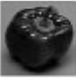
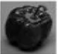
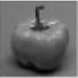
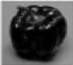
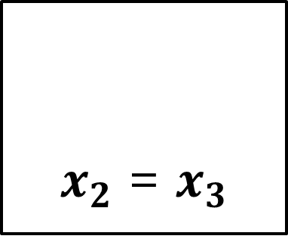

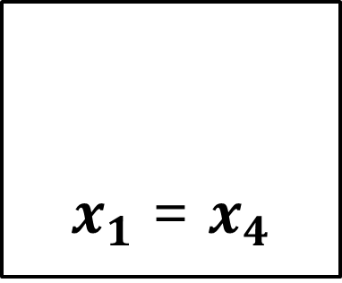
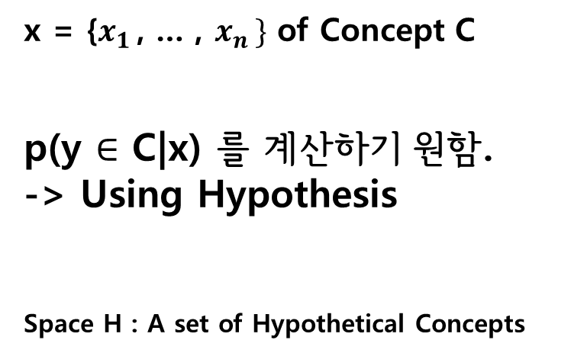
Concepts
C1
C2
x = {$x_{1 }$, … , $x_{n }\}$ of Concept C
p(y $∈$ C|x) 를 계산하기 원함.
-> Using Hypothesis
Space H : A set of Hypothetical Concepts
$x_{2}$ = $x_{3}$
$x_{1}$ = $x_{4}$
$$New y$$
?

Slide 9
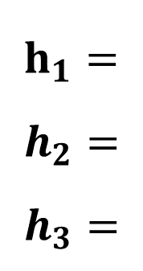
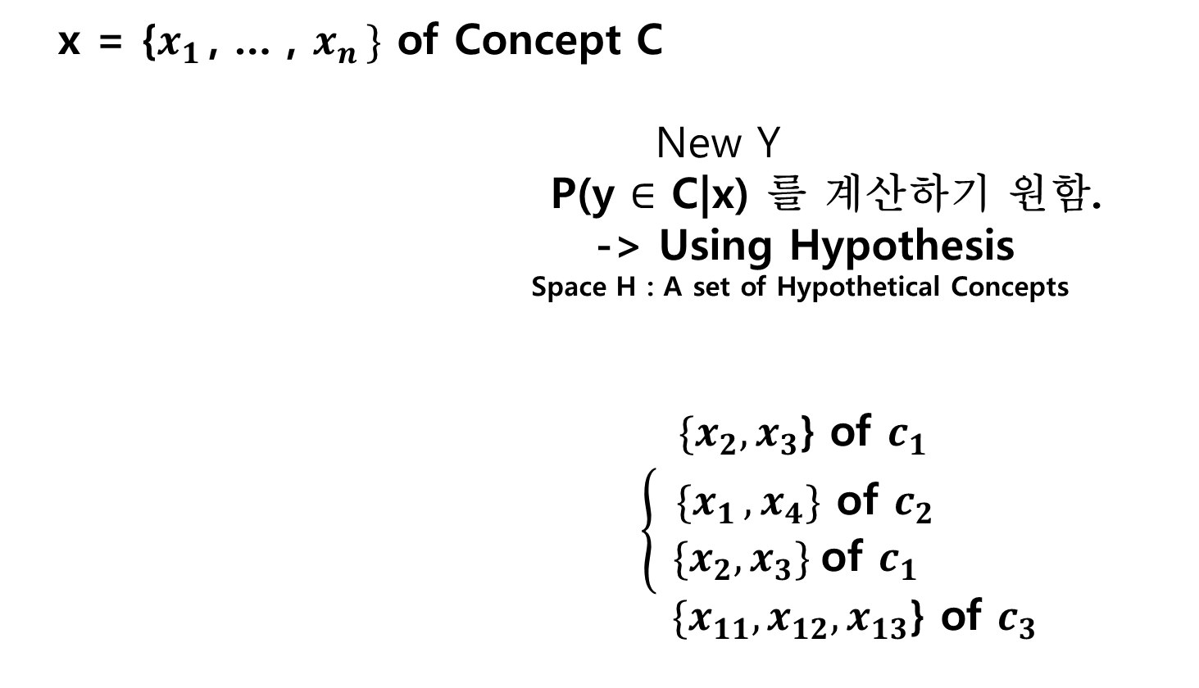
The Bayesian Generalization Framework
x = {$x_{1 }$, … , $x_{n }\}$ of Concept C
New Y
P(y $∈$ C|x) 를 계산하기 원함.
-> Using Hypothesis
Space H : A set of Hypothetical Concepts
${ \{x}_{2},x_{3}$} of $c_{1 }$
$\left\{\begin{aligned}{ \{x}_{1 },x_{4}\} \text{of} c_{2 } \\ {\{x}_{2},x_{3}\} \text{of} c_{1 }\end{aligned}\right.$
${ \{x}_{11},x_{12},x_{13}$} of $c_{3 }$
H
h2
h3
X1
X2
X3
X4…
X11
X12
X13 …
h1
$h_{1}=$
$$h_{2}=$$
$$h_{3}=$$
New
Concept

Slide 10
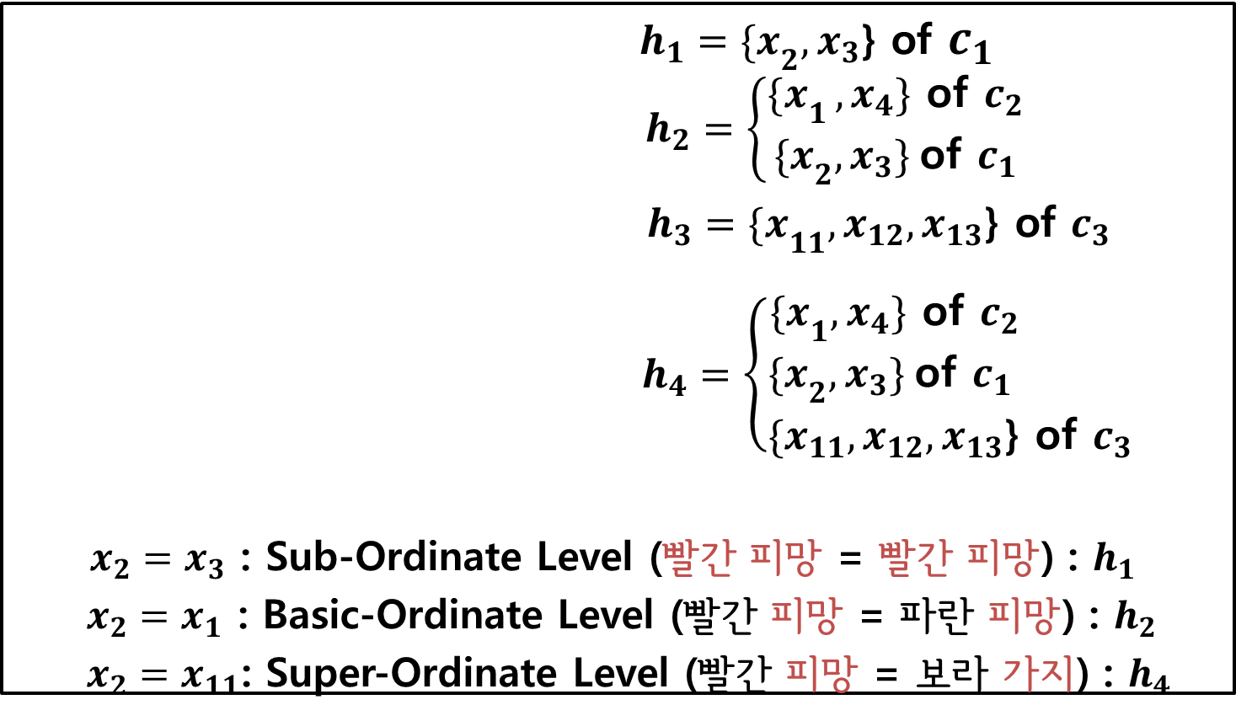
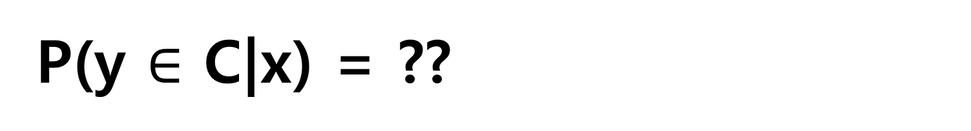
P(y $∈$ C|x) = ??
H
${h_{1}=\{x}_{2},x_{3}$} of $c_{1}$ $h_{2}=\left\{\begin{aligned}{\{x}_{1 },x_{4}\} \text{of} c_{2 } \\ {\{x}_{2},x_{3}\} \text{of} c_{1 }\end{aligned}\right.$
${h_{3}=\{x}_{11},x_{12},x_{13}$} of $c_{3 }$
$h_{4}=\left\{\begin{aligned}{\{x}_{1},x_{4}\} \text{of} c_{2 } \\ {\{x}_{2},x_{3}\} \text{of} c_{1 } \\ \{x_{11},x_{12},x_{13}\text{\} }\text{of} c_{3 }\end{aligned} \right.$
$x_{2}=x_{3}$ : Sub-Ordinate Level (빨간 피망 = 빨간 피망) : $h_{1}$
$x_{2}=x_{1}$ : Basic-Ordinate Level (빨간 피망 = 파란 피망) : $h_{2}$
$x_{2}=x_{11}$: Super-Ordinate Level (빨간 피망 = 보라 가지) : $h_{4}$
h2
h3
X11
X12
X13 …
h4
X1
X2
X3
X4…
h1
X21
X22
X23 …
h5

Slide 11
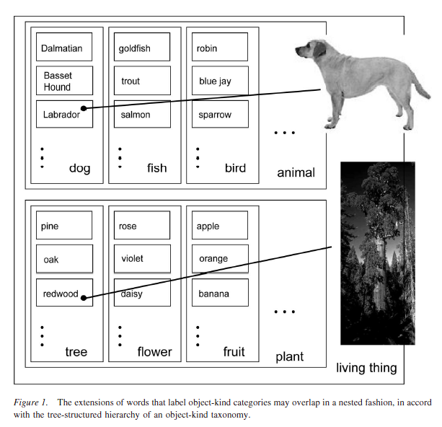
The Bayesian Generalization Framework

Slide 12
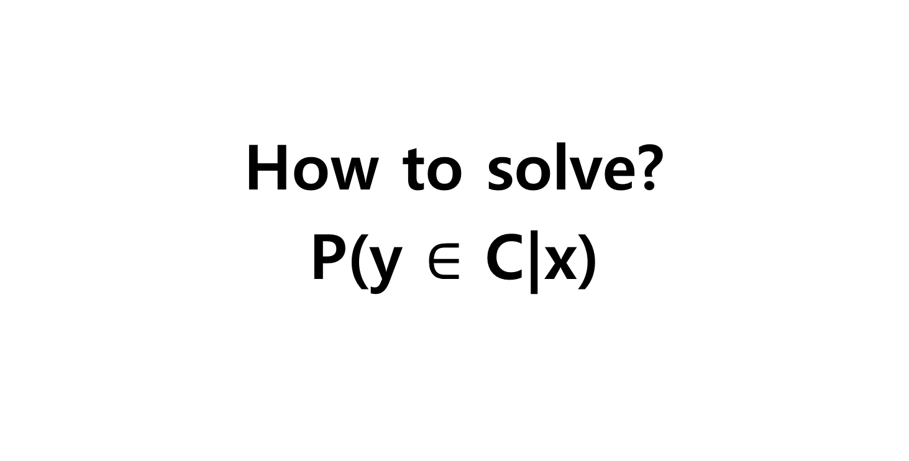
The Bayesian Generalization Framework
How to solve?
P(y $∈$ C|x)

Slide 13
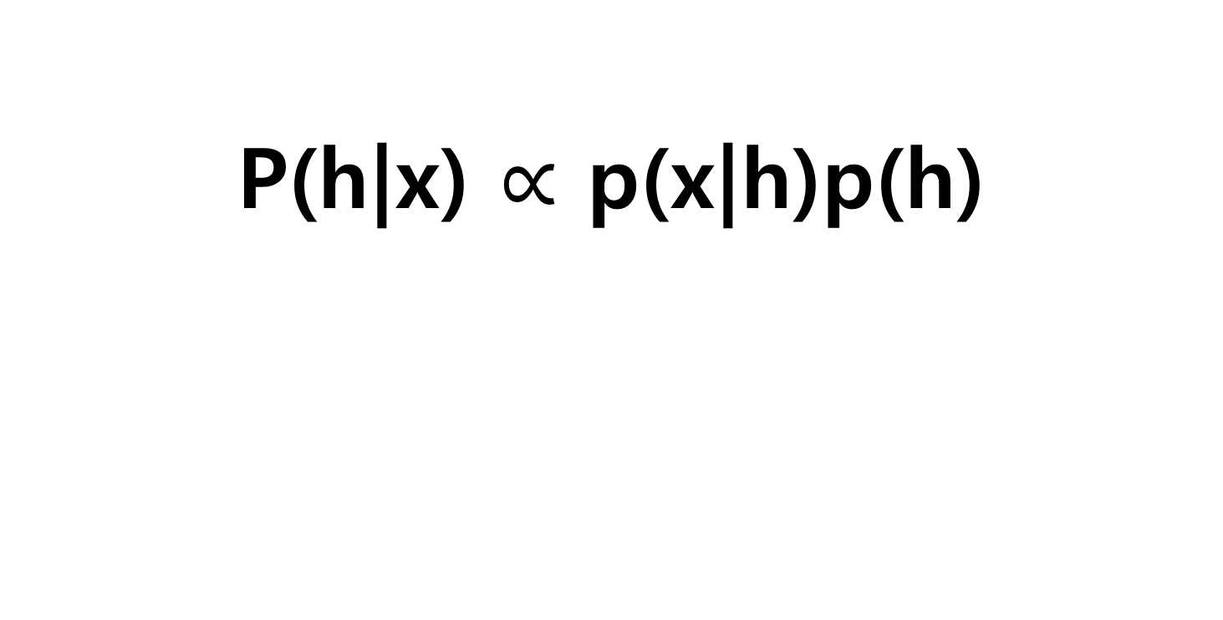
Bayes rule
P(h|x) $∝$ p(x|h)p(h)
Posterior
Likelihood
Prior

Slide 14

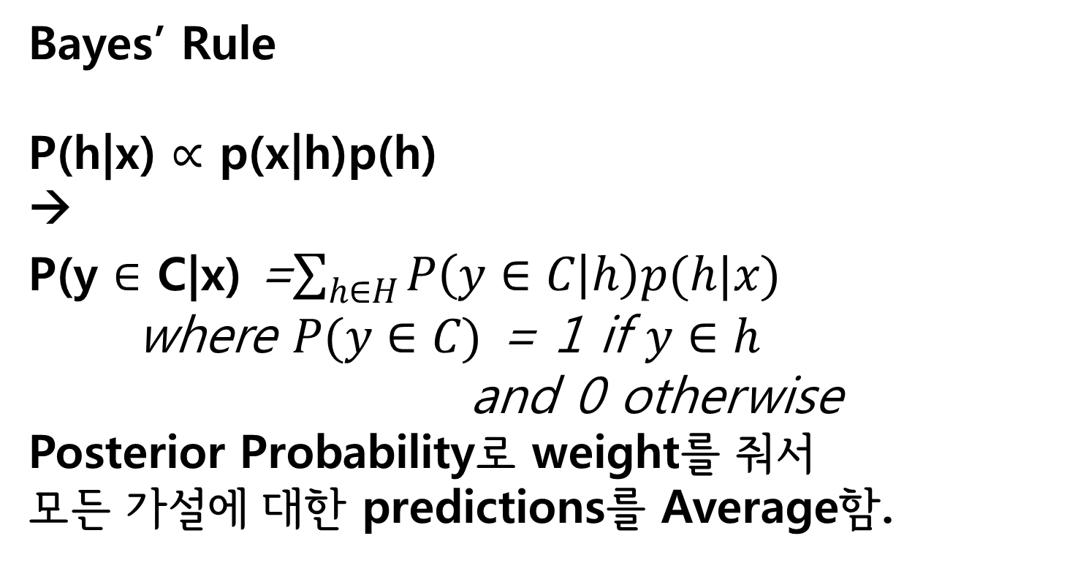
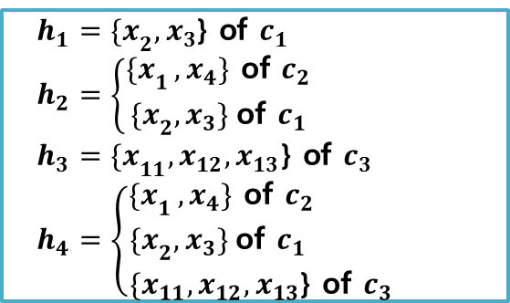
The Bayesian Generalization Framework
H
${h_{1}=\{x}_{2},x_{3}$} of $c_{1 }$
$h_{2}=\left\{\begin{aligned}{\{x}_{1 },x_{4}\} \text{of} c_{2 } \\ {\{x}_{2},x_{3}\} \text{of} c_{1 }\end{aligned}\right.$
${h_{3}=\{x}_{11},x_{12},x_{13}$} of $c_{3 }$
$h_{4}=\left\{\begin{aligned}{\{x}_{1 },x_{4}\} \text{of} c_{2 } \\ {\{x}_{2},x_{3}\} \text{of} c_{1 } \\ \{x_{11},x_{12},x_{13}\text{\} }\text{of} c_{3 }\end{aligned} \right.$
h3
Bayes’ Rule
P(h|x) $∝$ p(x|h)p(h)
→
P(y $∈$ C|x) =$\sum_{h∈H}{P\left(y∈C | h\right)p(h|x)}$
where $P(y∈C)$ = 1 if $y∈h$
and 0 otherwise
Posterior Probability로 weight를 줘서
모든 가설에 대한 predictions를 Average함.
h2
X1
X2
X3
X4…
X11
X12
X13 …
h1
P(y $∈$ C|x) = $\sum_{h\text{∋}y,x}{p(h|x)}$

Slide 15
The Bayesian Generalization Framework
Prior
Uniform Distribution (Shepard, 1987)
A Stochastic Process over Structures(Kemp & Tenenbaum, 2009)
And so on.

Slide 16
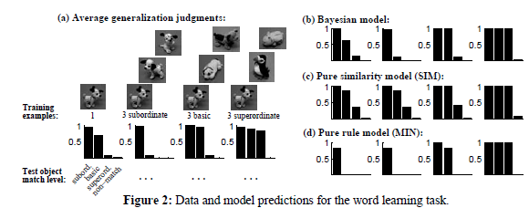
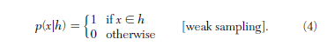
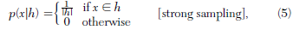
The Bayesian Generalization Framework
Likelihood(Tenebaum and Griffiths(2001))
Weak Sampling
Strong Sampling
각 Objects들은 각 가설로부터 랜덤적으로 Uniformly generated

Slide 17
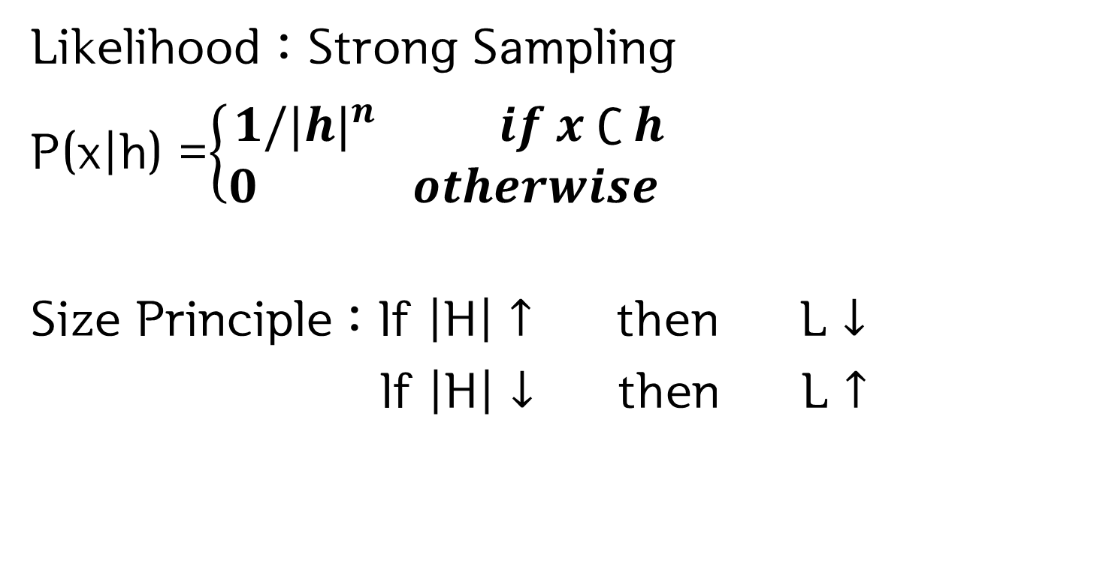
The Bayesian Generalization Framework
Likelihood : Strong Sampling
P(x|h) =$\left\{\begin{aligned}{1/|h|}^{n} if x ∁ h \\ 0 otherwise \end{aligned}\right.$
Size Principle : If |H| $↑$ then L $↓$
If |H| $↓$ then L $↑$

Slide 18
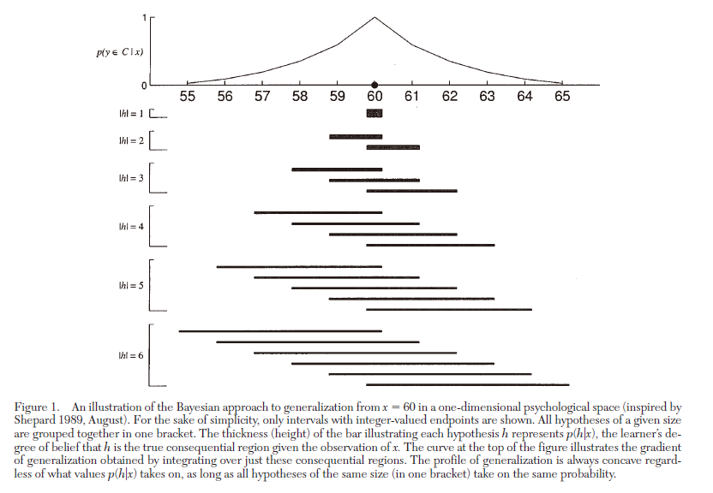
Why Strong Sampling?

Slide 19
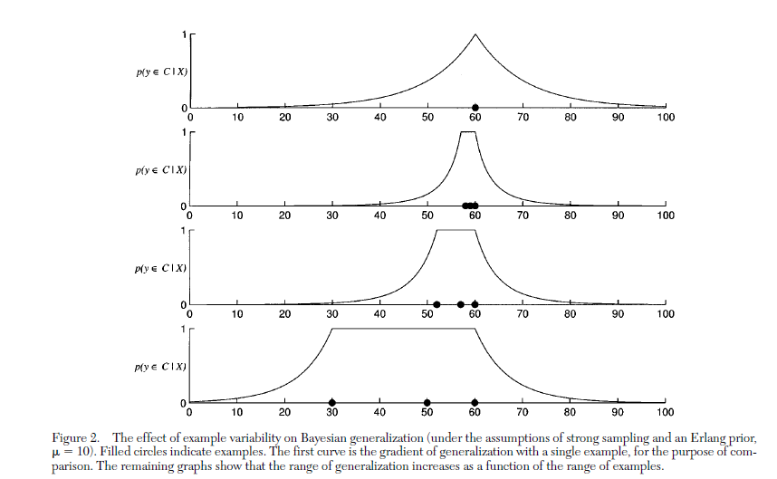
Why Strong Sampling?

Slide 20
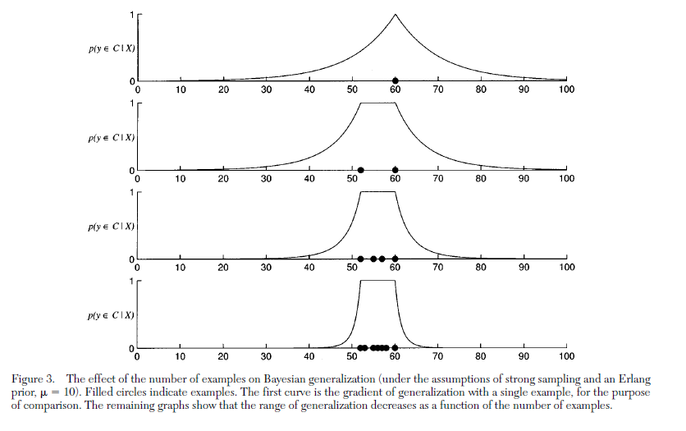
Why Strong Sampling?

Slide 21
Contents
3. Hierarchical Clustering
→ Bayesian Inference

Slide 22
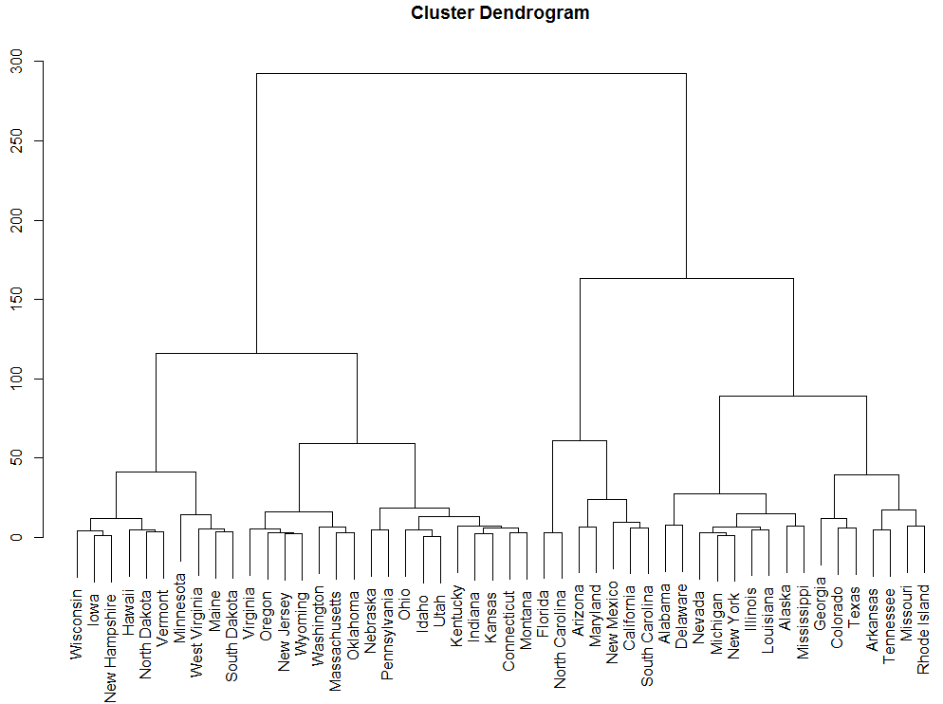
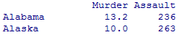
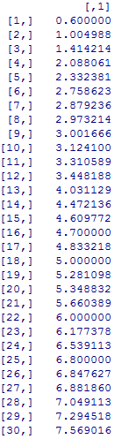
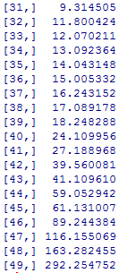
EX) Hierarchical Clustering

Slide 23
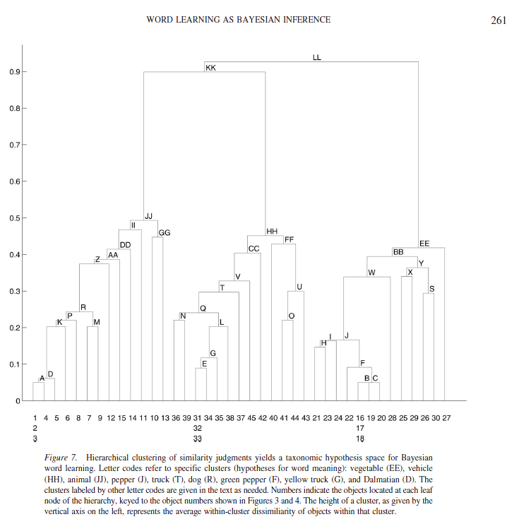
Word Learning as Bayesian Inference
Xu and Tenenbaum(2007)
Hierarchical Clustering 이용
15 images per concept
Pair of 2 objects
403회 유사 판단
(1 ~ 9) Scale: 45분 소요..
Nodes <- Potential Words(Hypotheses)[Alphabet]
Leaves <- the Domain of Possible Objects[Number]

Slide 24
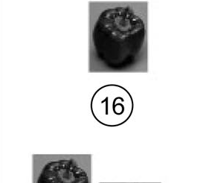
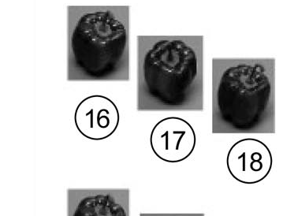
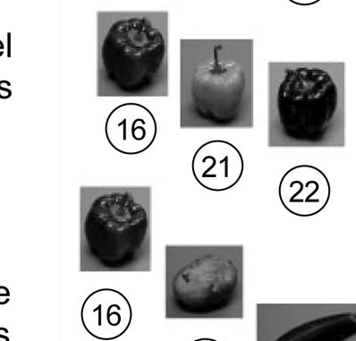
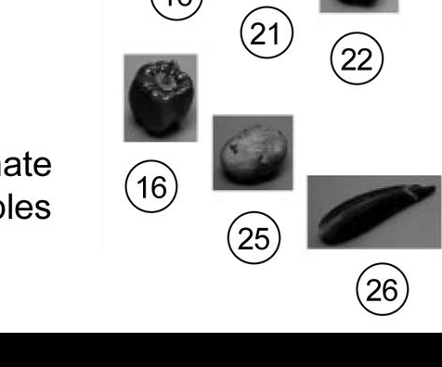
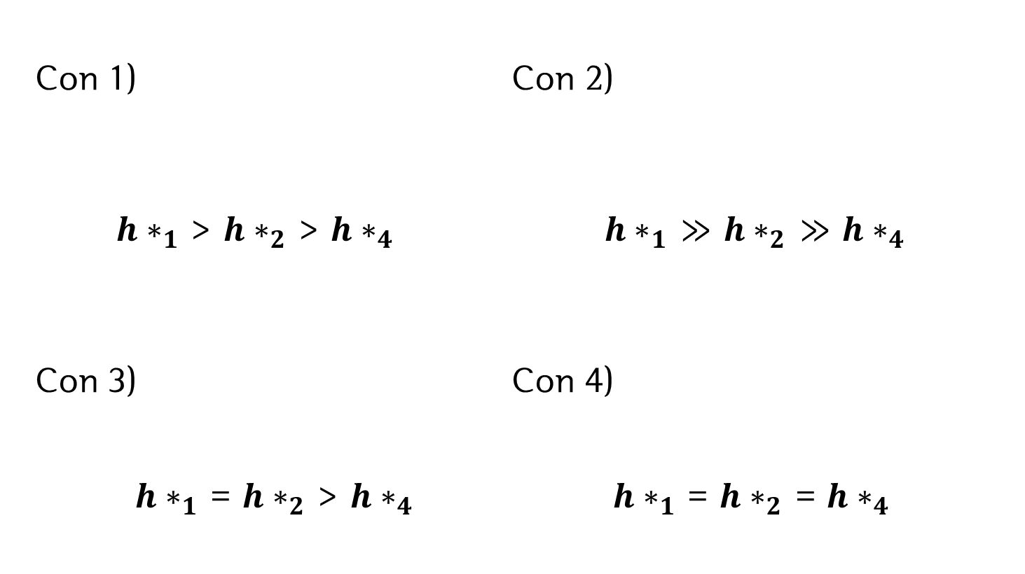
The Bayesian Generalization Framework
Con 1) Con 2)
${h∗}_{1}$ > ${h∗}_{2}$ > ${h∗}_{4}$ ${h∗}_{1}$ $≫$ ${h∗}_{2}$ $≫$ ${h∗}_{4}$
Con 3) Con 4)
${h∗}_{1}$ = ${h∗}_{2}$ > ${h∗}_{4}$ ${h∗}_{1}$ = ${h∗}_{2}$ = ${h∗}_{4}$

Slide 25
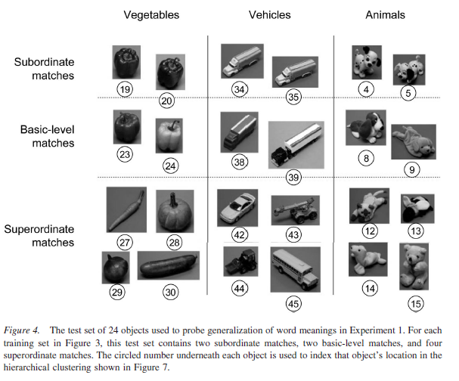
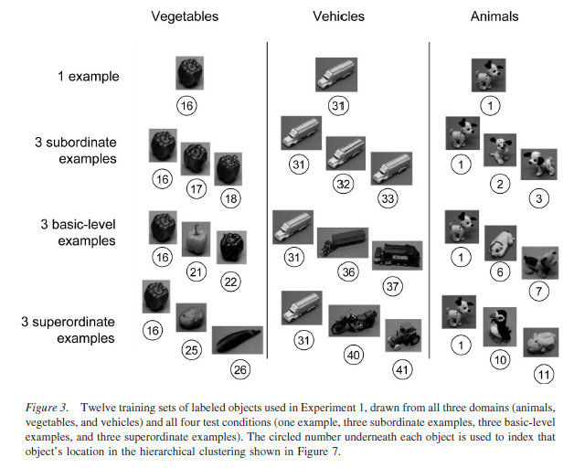
Word Learning as Bayesian Inference

Slide 26
Word Learning as Bayesian Inference
Design and Procedure
Training : 12 Trials (Domains*3, Levels*4)
Each Trials ->
Each Test(sub*2 + Basic*2 + Super*4)

Slide 27
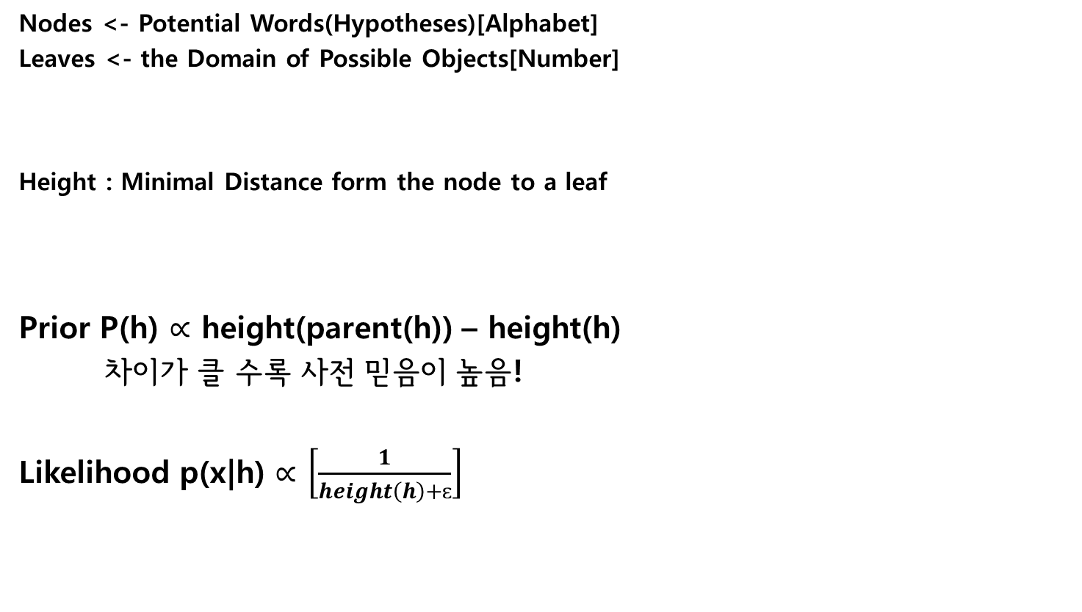
Word Learning as Bayesian Inference
Nodes <- Potential Words(Hypotheses)[Alphabet]
Leaves <- the Domain of Possible Objects[Number]
Height : Minimal Distance form the node to a leaf
Prior P(h) $∝$ height(parent(h)) – height(h)
차이가 클 수록 사전 믿음이 높음!
Likelihood p(x|h) $∝$ $\left[\frac{1}{height\left(h\right)+ɛ}\right]$
n
.05

Slide 28
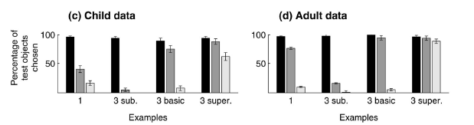
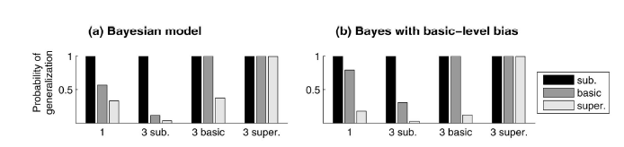
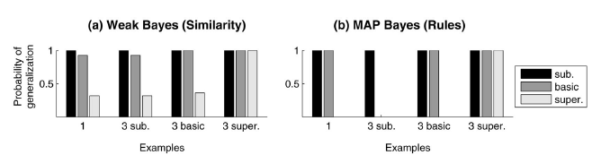
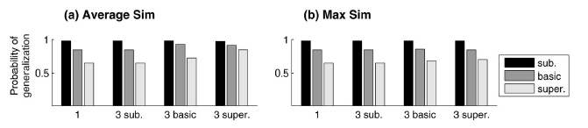
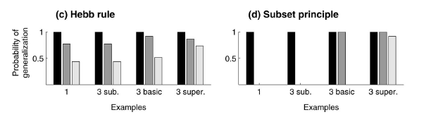
Word Learning as Bayesian Inference

Slide 29
Contents
4. Word-Net
→ Bayesian Inference

Slide 30
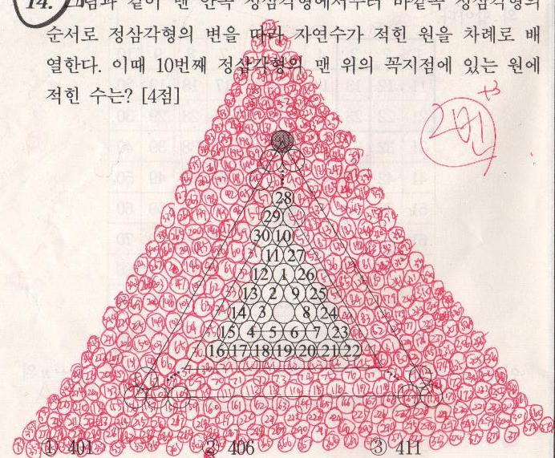
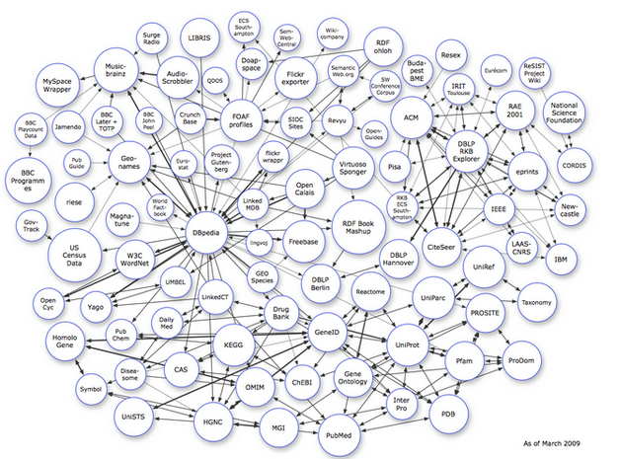


Word Learning as Bayesian Inference
VS

Slide 31
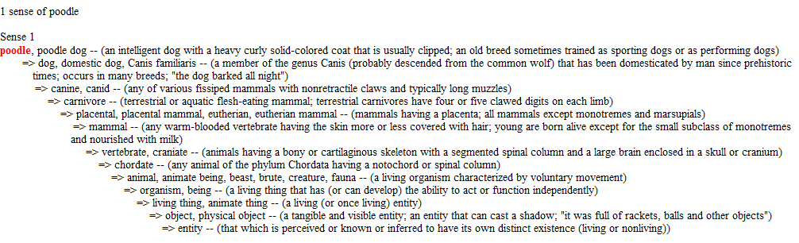
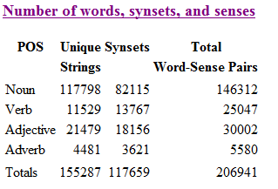
Large-Scale Word Learning
^{Bayesian Word Learning Model}
H <- Wordnet을 활용하여 자동으로 구성되게 함.
WorldNet : A large Lexical Data Base of English represented as a network of words linked by directed edges denoting semantic relatedness
By 프린스턴대학교 인지과학 연구소

Slide 32
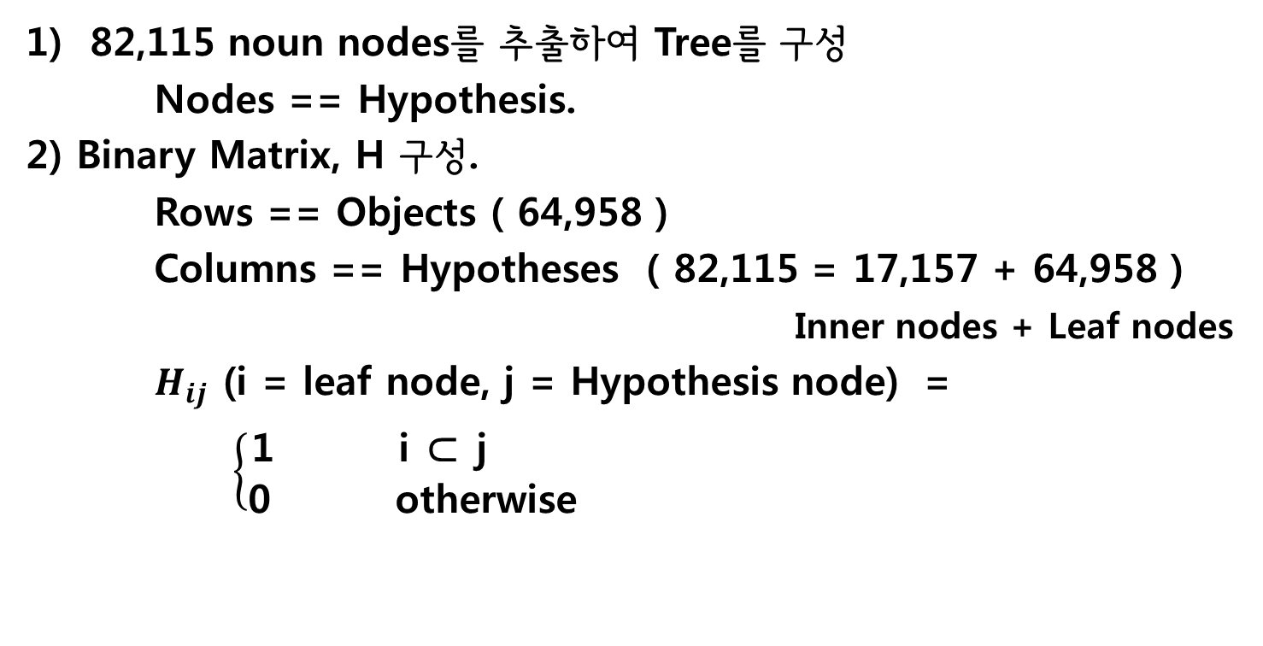
Large-Scale Word Learning
82,115 noun nodes를 추출하여 Tree를 구성
Nodes == Hypothesis.
2) Binary Matrix, H 구성.
Rows == Objects ( 64,958 )
Columns == Hypotheses ( 82,115 = 17,157 + 64,958 )
Inner nodes + Leaf nodes
$H_{ij}$ (i = leaf node, j = Hypothesis node) =
$\left\{\begin{aligned}\text{1 }\text{i}\text{ ⊂ }\text{j} \\ \text{0 }\text{otherwise} \end{aligned}\right.$
Subordinate Objects
구별 가능

Slide 33
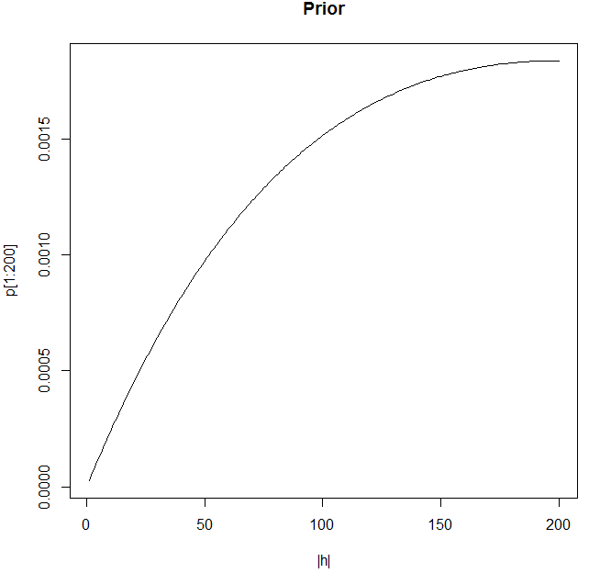


Large-Scale Word Learning
Bayesian Model
Prior :
σ = 200 by hand
Likelihood : P(x|h) =$\left\{\begin{aligned}{1/|h|}^{n} if x ∁ h \\ 0 otherwise \end{aligned}\right.$

Slide 34


Erlang Distribution = Distribution of sum of exponential variates
Prior
Shepard
(1987)
S : Particular size s

Slide 35

Why Erlang?
Prior
Shepard
(1987)

Slide 36


Monte Carlo Stimulation
Prior
Minkowski Power Metric Formula
Shepard
(1987)
K- dimensional space
i – i번째 자극
j – j번째 자극
공간에서 거리개념이 다를 수 있음.
r- 1 Rhombic
r- 2 Circular

Slide 37



수학적 증명
Prior
Shepard
(1987)
q(s) = Before encountering the first stimulus, It’s PDF
-> revise p(s) ~ Erlang PDF

Slide 38




Large-Scale Word Learning
2) Prototype Model
1] Define the Prototype of a set of objects, $X_{proto}$
to have those features owned by a majority of the objects in the set
Dist = Hamming Distance between the two vectors
Λ = free Parameter , here 0.15 by hand
using half-interval search
Pscore was normalized over all objects y

Slide 39
Half – Interval Search
Binary Search or Half-Interval Search
Ex) Telephone Book
Search for Smith
Rogers ………………… Thomas
Samson ……… Thomas

Slide 40


Large-Scale Word Learning
3) Exemplar Model
1] Define the Exemplar model using similar scoring metric
Compute a distance for each item $X_{j}$
Dist = Hamming Distance between the two vectors
Λ = free Parameter , here 0.20 by hand
using half-interval search
Escore was normalized over all objects y

Slide 41
Behavioral Experiments
Exp 1. Validating Out Approach – Xu and Tenenbaum(2007)
Within-Subjects Design
$0.05 for each training set, 34 participants
1) Training
4 Conditions : 각각 3 분류(Vegetables, Vehicles, Animals)
4 Levels : 총 12회 무선.

Slide 42
Behavioral Experiments
Test Sets were the same
8 Objects : two subordinate examples(e.g two other Dalmatians)
two basic-level examples (e.g a Cocker Spaniel and a Corgi)
four superordinate examples (e.g a cat, a bear, a sea lion, and a horse).
+ 16 non-matching objects
각 Trial 마다 다른 새로운 단어 (e.g “dak”)의 one or more examples을 보여줌.-> test set에 있는 물체로 부터 dak라는 것들을 선택.

Slide 43





Behavioral Experiments
Exp 1. Validating Out Approach
Result
$$r^{2}=.98$$
$r^{2}=.$66
$$r^{2}=.84$$

Slide 44

Behavioral Experiments
Exp2 ) Novel Domains
36 Participants, $0.05 for each trial

Slide 45







Behavioral Experiments
Exp2 ) Novel Domains
$$r^{2}=.97$$
$r^{2}=.$88
$r^{2}=.$91
$$r^{2}=.95$$
${Pr}^{2}=.$80
${Er}^{2}=.$90

Slide 46
Contents
5. Discussion

Slide 47
Discussion
** 의의
Hypothesis Space 손 -> 기계
Bayesian Model의 재검증
New Domain 적용
** 미래 연구
One Subordinate-level and One Basic-level Object
Heterogeneous Training Sets
2) Training과 Test 자극의 시각적 유사성에 따른 상호작용 효과
[ BWLM로는 불가 ]
3) 상식 추론에도 적용가능 from ConcepNet of OpenCyc

Slide 48





Simulation
Sub Basic Super
Sub Basic Super
Sub Basic Super
Sub Basic Super
Dump truck : |h| = 1
Truck : |h| = 24
Motor Vehicle : |h| = 78

Slide 49
References
J.T. Abbott, J.L. Austerweil, and T.L. Griffiths. “Constructing a hypothesis space from the web for large-scale Bayesian word learning”. Proceeddings of the 34th Annual Conference of the Cognitive Science Society, 2012
R.N. Shepard “Toward a Universal Law of Generalization for Psychological Science”, Science, Vol. 237, No.4820. 1987. pp.1317-1323
J.B. Tenenbaum “Rules and Similarity in Concept Leaning”. Advances in Neural Information Processing Systems 12. 2000. pp59-65
J.B. Tenenbaum and T. L. Griffiths. “Generalization, Similarity, and Bayesian inference”. Behavioral and Brain Sciences 24. 2001. pp 629-640
F. Xu and J.B. Tenenbaum. “Word Learning as Bayesian Inference”. Psychological Review. Vol. 114. No.2. 2007. pp 245-272

